Slide 1
SPROCKET CENTRAL PTY. LTD
Data Analytics approach

Slide 2
TABLE OF CONTENTS
INTRODUCTION
EXPLORATORY DATA ANALYSIS
MODEL DEVELOPMENT
INTERPRETATION

Slide 3
INTRODUCTION
For new customers :
Number of cars owned
Job category
Wealth segments
Age distribution
No. of bikes purchased in the last 3 years

Slide 4
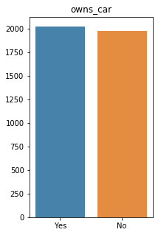
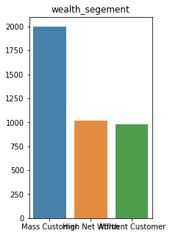
EXPLORATORY DATA ANALYSIS
One of the assumption which could have been made that people who own a car will not purchase bikes , however that is not the case.
Below we see the distribution of wealth segment and mass customer purchases the most number of bikes as compared to the rest.

Slide 5
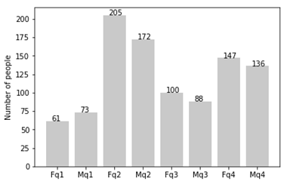
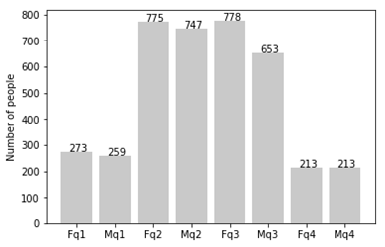
q1: Under 25; q2: 25 to 48; q3: 48 to 59; q4: Over 59
CUSTOMERS AGE DISTRIBUTION
As we can see mostly the new customers are from age 25 to 48.
Number of customers from 48 to 59 see a big drop .
There is a slight increase in number of customers over 59 years.
It looks like the percentages of under 25 years old not really change.
NEW
OLD

Slide 6
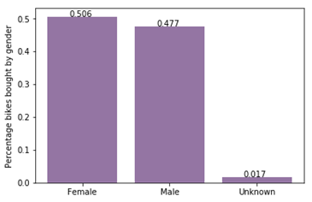
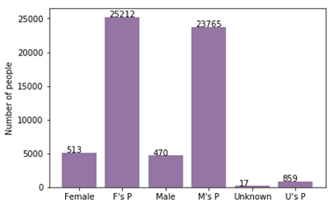
MODEL DEVELOPMENT
Bike purchased in last 3 years
As you can see, new customers mostly Female with 50.6% purchases with total of 25,212 bikes
Male contributed to 47.7% purchases with 23,765 bikes
So we should focus on advertises on Female customers than Male customers

Slide 7
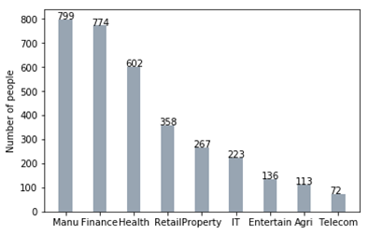
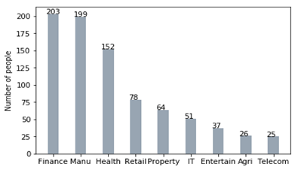
INTERPRETATION
Job Industry category
Mostly our new customers are on Finance industry and our Manufacturing customers are still on top 2.
There is not a lot of difference in the rest of the industries .
NEW
OLD

Slide 8
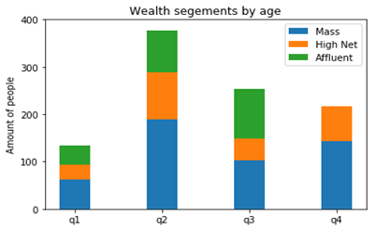
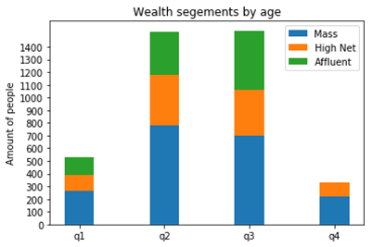
INTERPRETATION
WEALTH SEGMENT
In all ages, the number of Mass Customers is the highest so we should focus on this social class.
After that, we should focus on High Net Customer.
Then Affluent Customers but mostly second and third quadrant
NEW
OLD

Slide 9
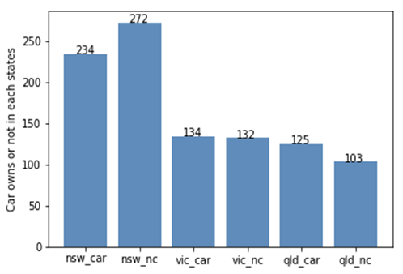
INTERPRETATION
NUMBER OF CARS OWNED
NSW should be considered the most since numbers of customers don’t own cars is significantly larger than that own.
VIC and QLD has more customers that own car that who don’t but we can try to have something so that those owns car will buy bikes.

